Slide 1
Web Programming
MOD002619
Week 4
Django Templates

Slide 2
Session content
Recap
Object Relational Mapping (ORM)
URL Paths
Templates

Slide 3
4.1 Recap
Web Programming
Week 4 Part 4.1

Slide 4
Recap
Virtual Environment – restart with
  Windows
    .\venv\Scripts\activate.bat
  Linux
    source ./venv/bin/activate
Simply site started with
  python manage.py runserver
    http://127.0.0.1:8000/ - just a welcome page
    http://127.0.0.1:8000/admin - The admin site, not very user friendly

Slide 5
4.2 Object Relational Mapping (ORM)
Web Programming
Week 4 Part 4.2

Slide 6
Object Relational Mapping (ORM)
Used to query and manipulate the data.
  We have used some of this in our script to import data from a CSV
Full details of how to use the API can be found on the Django site
As we move forward this is how we will populate the data onto our web pages
Can be used within a python shell.
  Start the shell:
    python manage.py shell

Slide 7
Simple Query
Firstly import our ‘Student’ model
  >>from myApp.models import Student
We can now get a result set back from our database.
  >> students = Student.objects.all()
We can now access a single Student as if from an array.
  >> student = students[0]
And then access the attributes of that object
  >> print( student.firstName )

Slide 8
Other simple queries
Access a single object by id
  student = Student.objects.get( id=2 )
Will throw an error if no object meets the criteria
  pUniapp.models.Student.DoesNotExist: Student matching query does not exist.
Can use other attributes but again these can throw errors
  student = Student.objects.get( age=18 )
  myApp.models.Student.MultipleObjectsReturned: get() returned more than one Pet -- it returned more than 20!

Slide 9
Handling non unique returns
Use the filter method which returns a ResultSet
  student = Student.objects.filter(age=18)
  print(student)
  <QuerySet [<Student: Student object (24)>, < Student : Student object (38)>, < Student : Student object …
  print(student[1].firstName)
  Joshua

Slide 10
Handling Relationships
Remember our Students can be enrolled on a series of Module, examining the database we can see for ID=7 this is not empty
  student = Student.objects.get( id=7 )
  modules = student.modules.all()
  print( modules )
  <QuerySet [<Module: Module object (3)>,
< Module : Module object (4)>]>
  print( modules[1].name )
  Introduction to Programming

Slide 11
4.3 URL Path Handling
Web Programming
Week 4 Part 4.3

Slide 12
URL dispatcher
URL’s are defined on an App by App basis in a python module called URLconf
Uses definitions in python mapping between URLs and views
Remember currently we have two apps admin and myApp
We will leave admin for now and concentrate on our specific app

Slide 13
Project/urls.py
Current state of URL patterns
from django.contrib import admin
from django.urls import path
urlpatterns = [
path("admin/", admin.site.urls),
]
This maps oursite/admin to the predefined admin page we have seen

Slide 14
Expected behaviour
We should have a home view rather than the default page we have seen
Appending our appname with a number to our website URL should take us to a page with details of that number object instance e.g.:
  http://127.0.0.1:8000/myApp/1/
  Should take us to a view of the first Pet object instance.

Slide 15
Amend URL paths – project directory
from django.contrib import admin
from django.urls import include, path
urlpatterns = [
path("", include("myApp.urls")),
path("admin/", admin.site.urls),
]
Note the include here is pushing the routing responsibility to a usrls.py in the app directory.

Slide 16
New URL paths file – App Directory
from django.contrib import admin
from django.urls import path
from . import views
urlpatterns = [
path('', views.home, name="home"),
path('myApp/<int:student_id>/', views.student_detail, name='student_detail'),
]
Note we will need to create functions for views.home and views.student_detail.

Slide 17
Details
URL patterns are checked in order top to bottom.
  The include myApp.urls in the project urls.py mean that the paths within that file are analysed first.
If pattern is matched, the function is called e.g. myApp.views.home.
If the bottom is reached without a match a HTTP 404 is returned.
In the angle brackets we are using an Integer type so will match with any integer here - the value here is then assigned to the variable student_id in our view function.
  Other converter type can be found in the Django documentation.

Slide 18
Simple Check for URL paths
Add some default functions to myApp/views.py
# not being used yet need templates first
from django.shortcuts import render
# just testing that the URL routing is working for now
from django.http import HttpResponse
from .models import Student
def home(request):
return HttpResponse("<h1>This is my home page!</h1>")
def student_detail(request, student_id):
# Response with student id
return HttpResponse(F"<h1>Student Number: {student_id}")

Slide 19
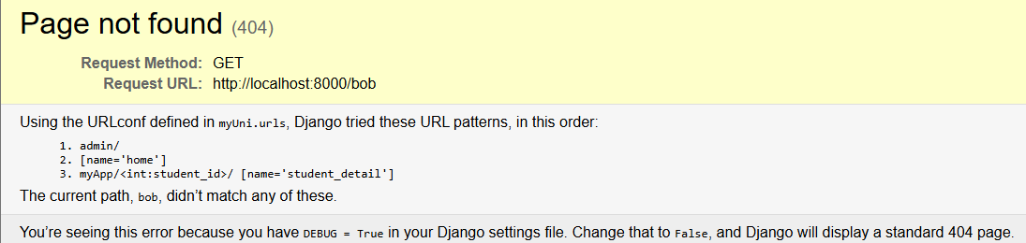
Run tests
Try the following URLs (note if using codespaces paths will be different)
  http://127.0.0.1:8000/
  http://127.0.0.1:8000/myApp/4/
  http://127.0.0.1:8000/bob/

Slide 20
The home page
We would like a home pages that lists all the Students by name
For this we need to create a home.html page and then render it
  Firstly, change the views.py function for the home request:
  Then write the home.html in a new folder myApp/templates

Slide 21
Modified Views for Home
def home(request):
# perform an ORM query to get all the students
students = Student.objects.all()
# call render method defining template to use
# 'home.html and pass pets through as an
# argument in a dictionary
return render(request,'home.html’,
{'students':students,})

Slide 22
Render Call Explaplained
render(request, 'home.html’,{'students':students,})
Simply just passed on as is
Will render the file: appname/templates/home.html
A dictionary of name value pairs in this case the object we created students (all the students in our data database) which we can refer to by the name ‘students’ in home.html

Slide 23
Home Page
Create the file appname/templates/home.html
Place some html in the page to check it works
<!doctype html>
<head>
<!-- Normal header stuff -->
<title>Nigel’s University</title>
</head>
<body>
<h1>My University</h1>
</body>
</html>

Slide 24
Templates
Templates have their own syntax
When the template engine encounters a variable, it evaluates that variable and replaces it with the result.
  {{variable}}
You can modify variables for display by using filters. Filters can be “chained.” The output of one filter is applied to the next.
  {{variable | filter}}
Tags are more complex than variables: Some create text in the output, some control flow by performing loops or logic, and some load external information into the template to be used by later variables.
  {% tag %}

Slide 25
Example Loop in home.html
<ul>
{% for student in students %}
<li>
<a href="{% url 'student_detail’student.id %}">
{{student.firstName|capfirst}}
{{student.lastName|capfirst}}
</a>
</li>
{% endfor %}
</ul>

Slide 26
Example Loop in home.html - 1
<ul>
{% for student in students %}
<li>
<a href="{% url 'student_detail’student.id %}">
{{student.firstName|capfirst}}
{{student.lastName|capfirst}}
</a>
</li>
{% endfor %}
</ul>
for tag with endfor for completing the loop

Slide 27
Example Loop in home.html - 2
<ul>
{% for student in students %}
<li>
<a href="{% url 'student_detail’student.id %}">
{{student.firstName|capfirst}}
{{student.lastName|capfirst}}
</a>
</li>
{% endfor %}
</ul>
Students object passed from views.py

Slide 28
Example Loop in home.html - 3
<ul>
{% for student in students %}
<li>
<a href="{% url 'student_detail’student.id %}">
{{student.firstName|capfirst}}
{{student.lastName|capfirst}}
</a>
</li>
{% endfor %}
</ul>
Building a URL consisting of student_detail and an id as defined in myApp.urls.py

Slide 29
Example Loop in home.html - 4
<ul>
{% for student in students %}
<li>
<a href="{% url 'student_detail’student.id %}">
{{student.firstName|capfirst}}
{{student.lastName|upper}}
</a>
</li>
{% endfor %}
</ul>
Using a filter to give a nice consistent format.

Slide 30
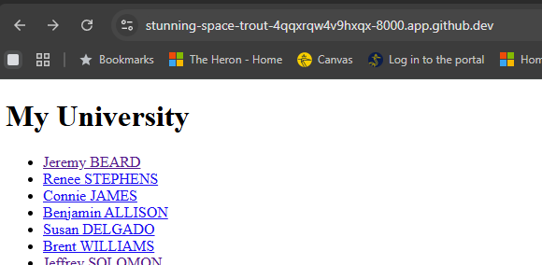
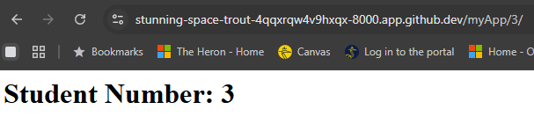
Output
Home
Selecting Connie James

Slide 31
Template Inheritance
Often, we have websites with common headers and footers, Django enables you to use inheritance.
A ‘base’ page can define common content, identifying specific blocks which then can be filled with our specific html files

Slide 32
Example base.html
<!doctype html>
<head>
<!-- Normal header stuff -->
</head>
<body>
<!-- Common body header stuff -->
<h1>My University</h1>
{% block content %}
{% endblock %}
<!-- Common footer stuff -->
</body>
</html>

Slide 33
Home.html Extending Base
{% extends "base.html" %}
{% block content %}
<!– Actual content-->
.
.
.
{% endblock %}

Slide 34
Views.py for Student Details
from django.http import Http404 # needed for 404 response
def student_detail(request, student_id):
try:
# perform an ORM query to get a specific student
student = Student.objects.get(id=student_id)
except Student.DoesNotExist:
raise Http404(f"Student {student_id } not found!")
return render(request, "student_detail.html", {'student’:
student})

Slide 35
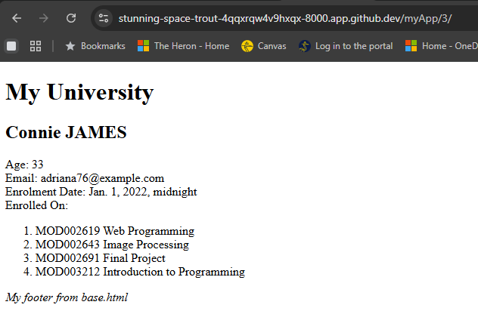
Student Detail Example:
Note to iterate over the many relationship in modules you need to use this syntax:
{% for module in student.modules.all %}

